Slide 1





Hosted by the University of Faisalabad
2nd International Congress on Social Sciences and Management Studies
MANAGEMENT AND SOCIAL TRANSFORMATION IN THE AGE OF ARTIFICIAL INTELLIGENCE
November 2-4, 2026
CLICK HERE TO EDIT THE MAIN HEADLINE STYLE
Name & Surname of Author(s)
Institution / Title Information
Notes:
null

Slide 2

General Information
  This presentation template is designed for use at the Academic Studies Congress.
  Images should be high resolution (minimum 300 DPI), and font sizes must be legible from the back of the room..
  Please be present in the hall or on the online platform before your session starts.
  Bring your presentation on a flash drive to the control desk and test it before the session begins

Slide 3
  Duration: Maximum 15 minutes for presentation + 5 minutes for Q&A
    The session chair may adjust the timing based on the session's intensity.
    Recommended length: Maximum 15 slides (including title and conclusion).
Presentation Format

Slide 4
  Summarize the 3-6 most important topics of your work.
    Bulleted Text List – Level 1
    Bullet Point – Level 1
    Bullet Point – Level 2
    Bulleted Text List – Level 1
Outline

Slide 5
  This slide summarizes the aims – objectives – and motivation for your study. For example, list the 3-5 most important goals you aim to achieve with your study.
    Bulleted Text List – Level 1
    Bullet Point – Level 2
    Bullet Point – Level 2
    Bulleted Text List – Level 1
Objectives

Slide 6
Colors and Font Sizes
  Use black or another dark color for text.
    Ensure maximum contrast with a white background.
    Font Types: Calibri or Arial.
  Font Types: Calibri or Arial.
  Main text: 32 pt.
  Secondary text: 28 pt.
  Minimum text: 24 pt (Do not use fonts smaller than 24 pt). Fonts smaller than 24 points (e.g., 20 points) are too small, so avoid using them.
    Warning: Yellow, gray, pink, or light blue colors may look good on a screen but may become unreadable when projected.

Slide 7
  Ensure that fonts, labels, and all other text are readable.
  It's good practice to add a short sentence or two summarizing the topic you've discussed at the bottom of each slide. This will be helpful for viewers who couldn't hear your verbal explanations.
Colors and Font Sizes

Slide 8
General Guidelines
  Keep the concepts as simple as possible.
  Include only one main idea on each page. Avoid line breaks.
  Ensure your audience focuses on you rather than reading long texts.
  It is recommended to use a maximum of 30 words per page.
  It is recommended to have a maximum of 6 lines of text per page.
    Use several simple shapes instead of one complex shape.
    Make copies of the pages you plan to refer to again later.
    It is recommended that you do not switch back and forth between pages during the presentation.
    It is recommended that you do not plan to return to a slide.
    Since the projector will not be connected to a sound system, it is recommended that you do not use sound effects.

Slide 9
Graphs and Figures
  Simple Drawings
  Simple drawings usually give the best results.
  Make all lines thick enough.
  Use dark colors to provide high contrast.
  Dotted, dashed lines, or other special lines should be thick and distinct.
  Font and Size
  Ensure that the fonts used in the figures are larger than 24 points. Use Calibri or Arial fonts in the figures as well.
  Avoid serif fonts such as Times New Roman. These fonts are suitable for printed materials but have poor readability on screens.
  Graphics
  Imported charts may have small fonts and thin lines.
  Correct these issues in the source program where the charts were created.

Slide 10
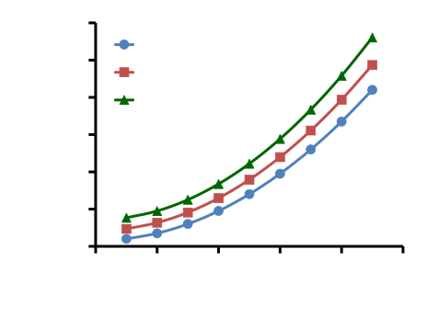
Graphs and Figures
A Good Example of a Shape
Simple graphic - bold, prominent axes - large fonts

Slide 11
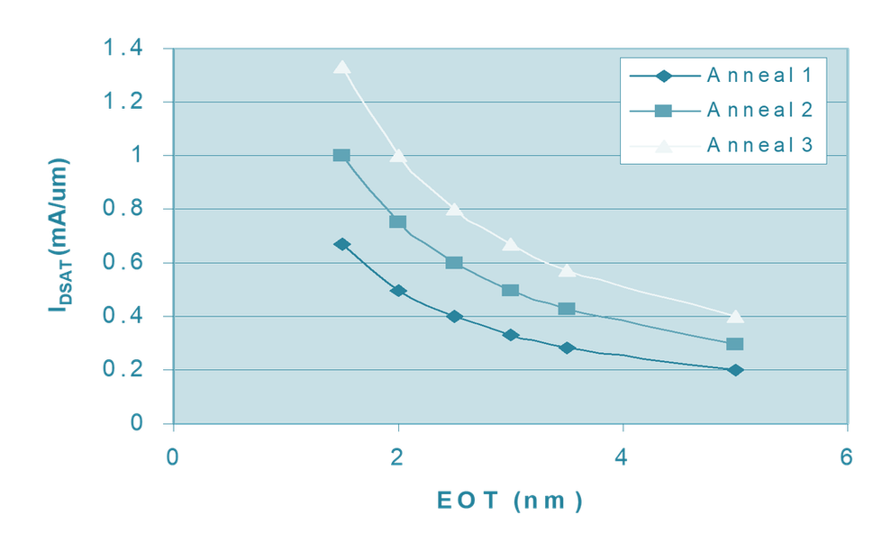
Graphs and Figures
A Bad Example
Light colors, poor contrast, very small text.

Slide 12
  Summarize the most important findings of your study in separate lines (3-6). Use short and clear statements that are easy for the audience to remember.
  Bulleted Text List – Level 1
  Bulleted Text List – Level 2
  Bulleted Text List – Level 2Bulleted Text List – Level 1
Conclusion

Slide 13
Save File
  Including TrueType Fonts in Your File
  Select the following options in order: “File”, “Save As”, “Tools” (or “Options”),
  “Save options”, or “Include fonts in file”.
  Alternatively:
  Select “File”, “Save As”, “Embed True Type” (Include True Type fonts). Name your file according to the following format:
  S-P_yazar.ppt
  S: Session number/Name, P: Presentation order
  Example: 5-3_Smith.ppt

